Slide 1

Word Processors? Ain’t Nobody Got Time For That: Introduction tO
By Holly Perryman
Wednesday, March 30th

Slide 2
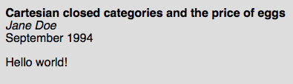
LATEX: What is it and why do I care?
A document preparation system for high-quality typesetting (NOT a word processor)
encourages authors can focus on content and not design!

Slide 3

LATEX: What is it and why do I care?
Feature include
Typesettings for journal articles, technical reports, books, and slide presentations
Control over large documents
Clean display of mathematical formulas
Automatic generation of bibliographies and indexes
And much more!
http://www.latex-project.org/

Slide 4
Presentation Outline
a general breakdown of documents/code
generating a bibliography
examples of basic equations, figures, and tables
taking a look at the UM LaTeX Template

Slide 5
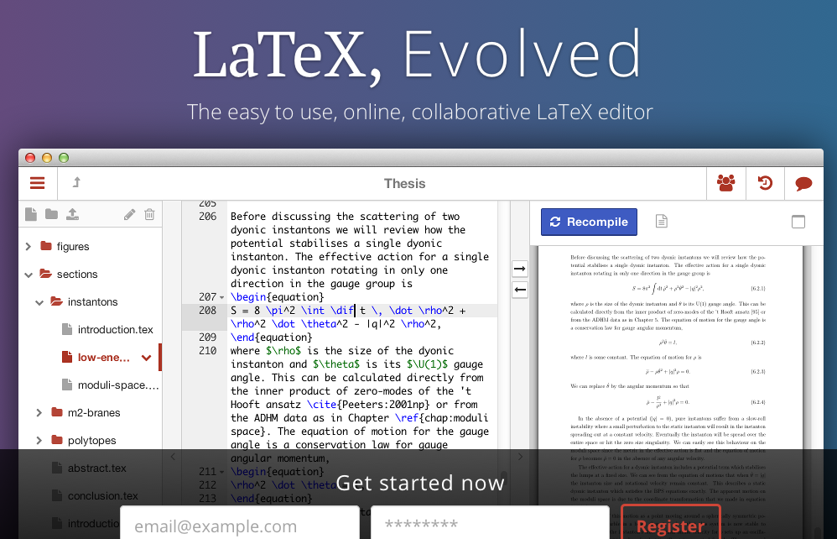
Getting it on your computer https://www.sharelatex.com/

Slide 6
A general breakdown of documents/code
“Input files” - files containing LaTeX code & Text for building a PDF (e.g., main.tex)

Slide 7
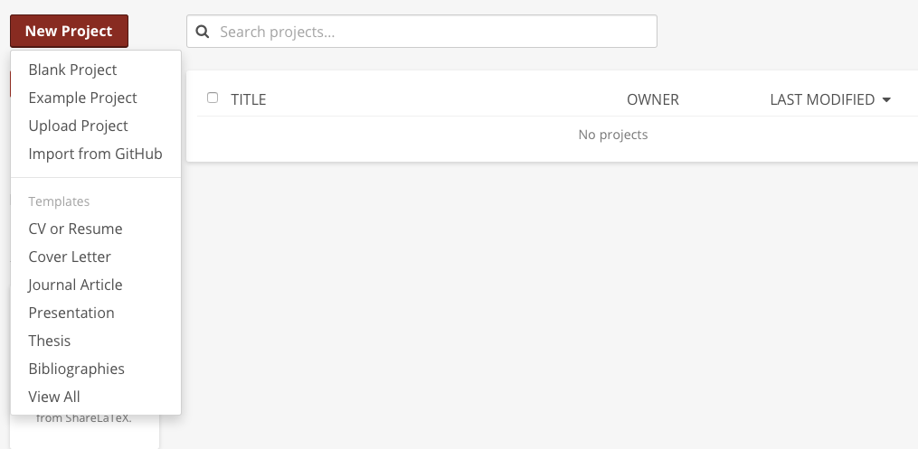

Slide 8


Slide 9
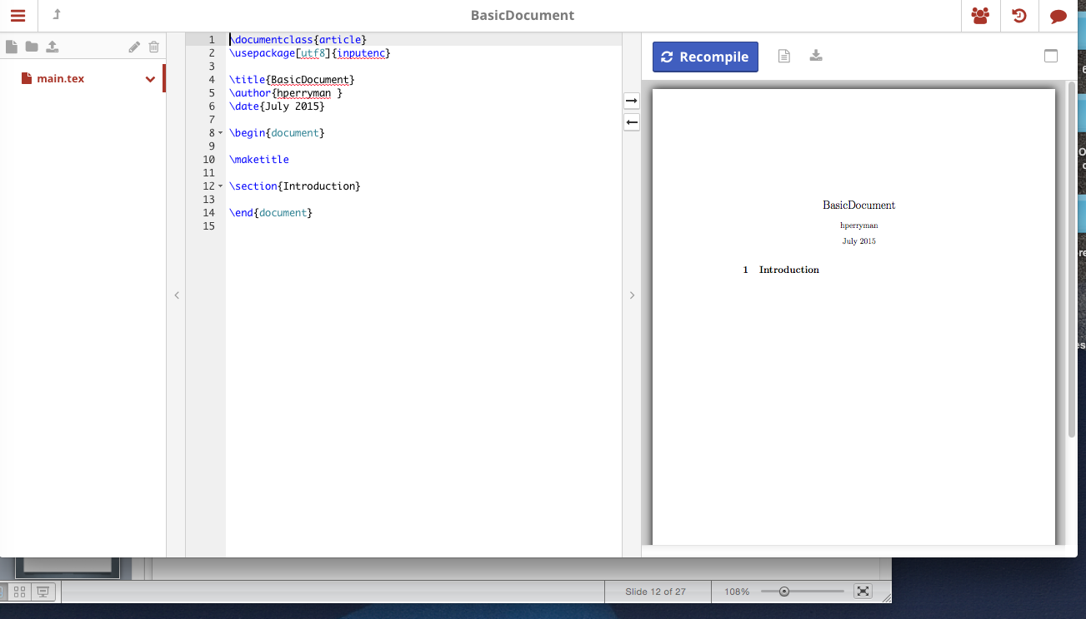

Slide 10
Menu
All the files and folders
for your project (this project is called
“BasicDocument”)

Slide 11
File Viewer
Displays the text (code) in the file selected in the Menu

Slide 12
PDF Viewer
Displays the PDF being created by this project

Slide 13
A general breakdown of documents/code
https://en.wikibooks.org/wiki/LaTeX/Document_Structure

Slide 14
A general breakdown of documents/code
https://en.wikibooks.org/wiki/LaTeX/Document_Structure
\documentclass
Identifies the type of document

Slide 15
https://en.wikibooks.org/wiki/LaTeX/Document_Structure
A general breakdown of documents/code
\begin{document}
Opens a document environment , which is the beginning of the document text

Slide 16
https://en.wikibooks.org/wiki/LaTeX/Document_Structure
A general breakdown of documents/code
\end{document}
Closes the document environment thus ending the document text

Slide 17
A general breakdown of documents/code
https://en.wikibooks.org/wiki/LaTeX/Document_Structure

Slide 18
A general breakdown of documents/code
https://en.wikibooks.org/wiki/LaTeX/Document_Structure
Preamble
Text Environment

Slide 19
A general breakdown of documents/code
https://en.wikibooks.org/wiki/LaTeX/Document_Structure
Declare document style, function packages, custom settings
Preamble

Slide 20
A general breakdown of documents/code
https://en.wikibooks.org/wiki/LaTeX/Document_Structure
\usepackage
Opens the package identified inside { }
Preamble

Slide 21
A general breakdown of documents/code
https://en.wikibooks.org/wiki/LaTeX/Document_Structure
Preamble
Custom settings

Slide 22
A general breakdown of documents/code
https://en.wikibooks.org/wiki/LaTeX/Document_Structure
Document text
and formatting
Text Environment

Slide 24
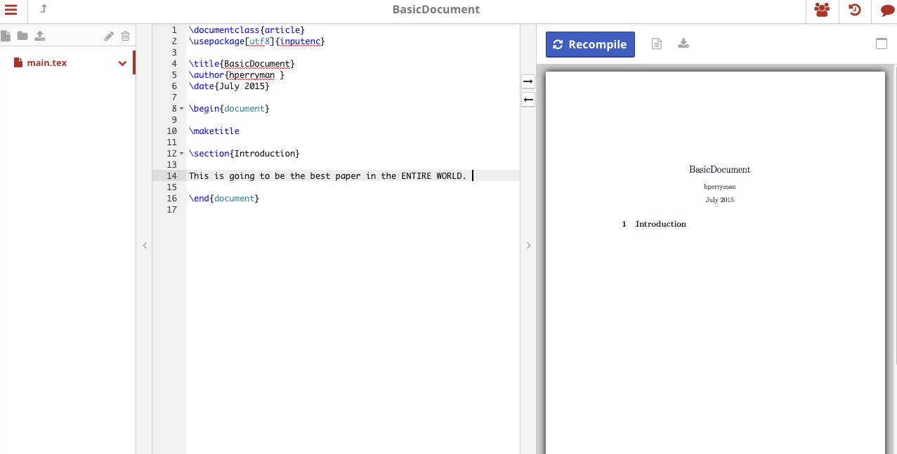

Slide 25
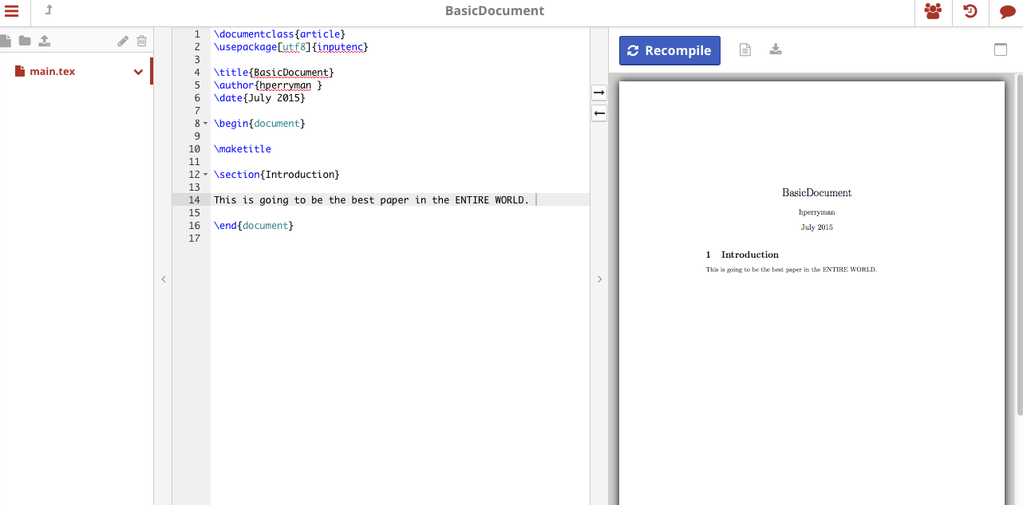

Slide 26
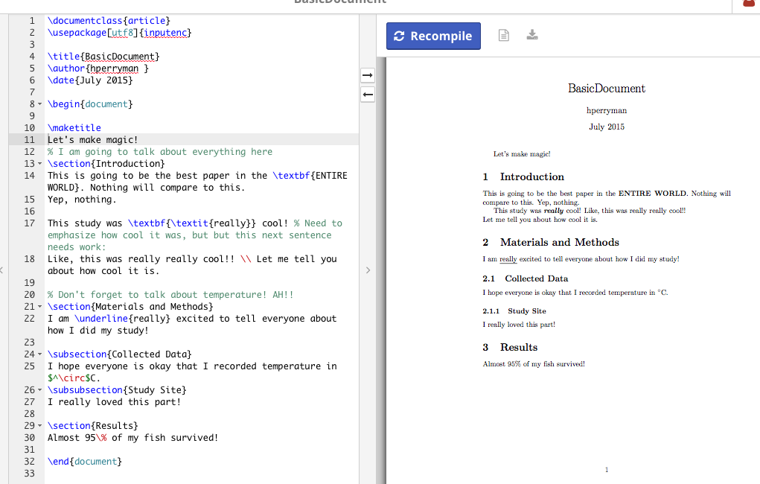

Slide 27
http://www.ntg.nl/doc/biemesderfer/ltxcrib.pdf
http://www.math.wisc.edu/~mitchell/learntex.pdf

Slide 28
A general breakdown of documents/code
“Input files” - files containing LaTeX code & Text for building a PDF (e.g., main.tex)
.tex files consist of a preamble and text environment
Preamble – declare document type & style, function packages, and custom functions
\usepackage – opens a package making certain functions accessible
Text environment – Text and text formatting

Slide 29
Presentation Outline
a general breakdown of documents/code
generating a bibliography
examples of basic equations, figures, and tables
taking a look at the UM LaTeX Template

Slide 30
Generating a bibliography
https://en.wikibooks.org/wiki/LaTeX/Bibliography_Management
List of Reference File - a file containing the list of references (e.g., referencelist.bib)
Reference declaration in a .bib file depends on reference type

Slide 31
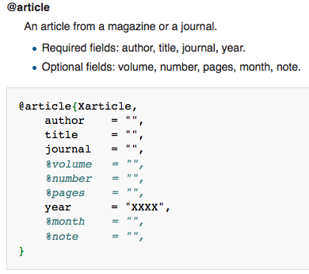
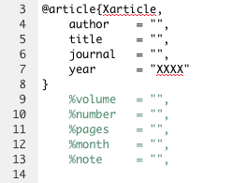
Example: Declaring article in .bib file

Slide 32
Example: Declaring book section with title in .bib file

Slide 33
Example: Declaring book section with title in .bib file
Identifier
How you cite the reference within the text

Slide 34
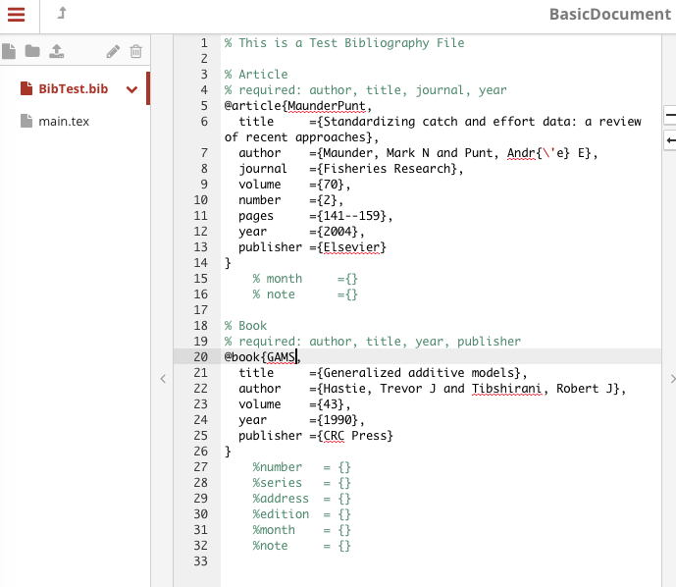
New File
Create a new file.
*remember the extension should be .bib

Slide 36
Make sure “and” separates each authors name

Slide 37
Formatting Ex.
\’
Inserts a dash above the following letter
(i.e., é)

Slide 38
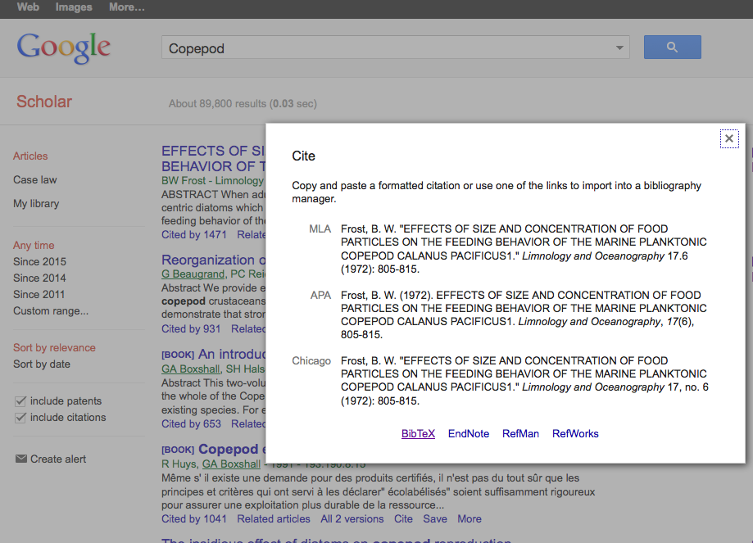
NOTE: Article search engines often have a BibTeX option for retrieving citation information
Just copy and paste code into your .bib file! Easy-peasy!
Make sure to check accuracy of reference

Slide 39
Generating a bibliography
https://en.wikibooks.org/wiki/LaTeX/Bibliography_Management
List of Reference File - a file containing the list of references (e.g., referencelist.bib)
Reference declaration in a .bib file depends on reference type
The input file (i.e.,the .tex file) needs to be altered slightly to call the .bib file
Open bibliography package
Declare bibliography style
Reference .bib file

Slide 40
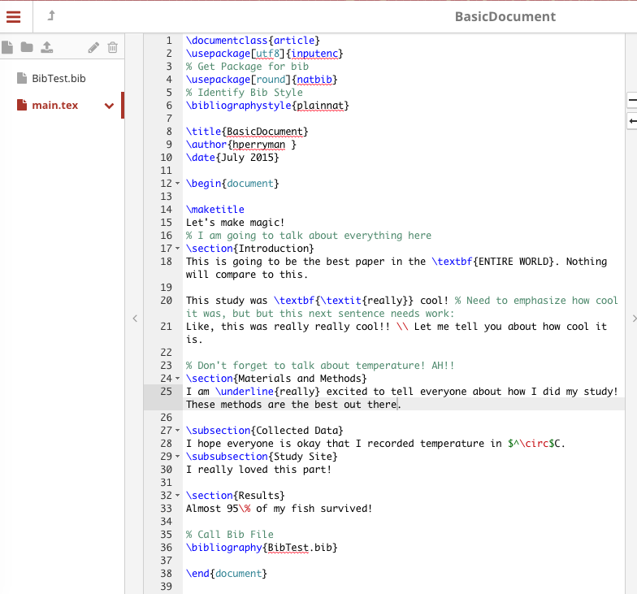




Slide 41
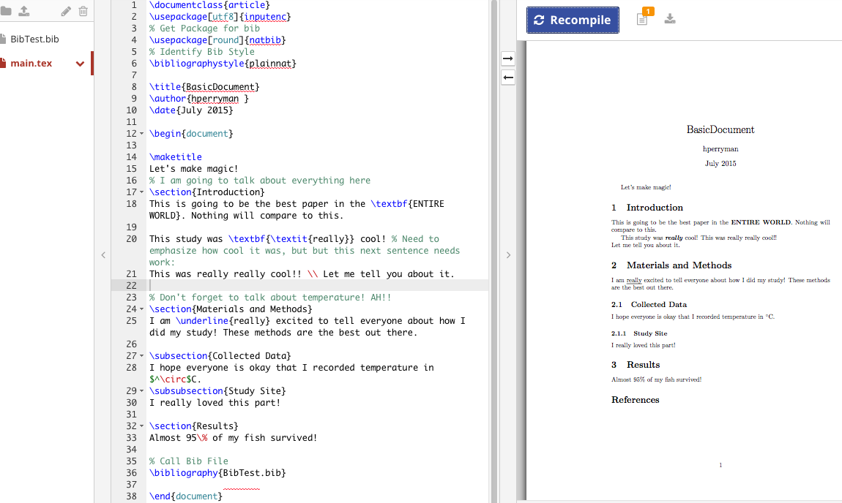

Slide 42
Generating a bibliography
https://en.wikibooks.org/wiki/LaTeX/Bibliography_Management
List of Reference File - a file containing the list of references (e.g., referencelist.bib)
Reference declaration in a .bib file depends on reference type
The input file (i.e.,the .tex file) needs to be altered slightly to call the .bib file
Bibliography is generated with the cited references, only
Functions used for in-text citations must correspond to declared bibliography package

Slide 43
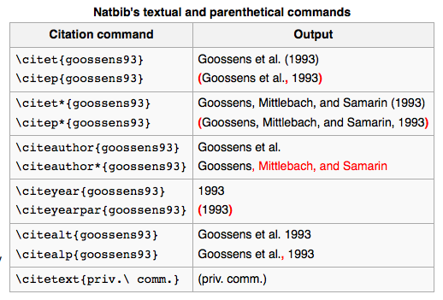
Generating a bibliography
https://en.wikibooks.org/wiki/LaTeX/Bibliography_Management

Slide 44
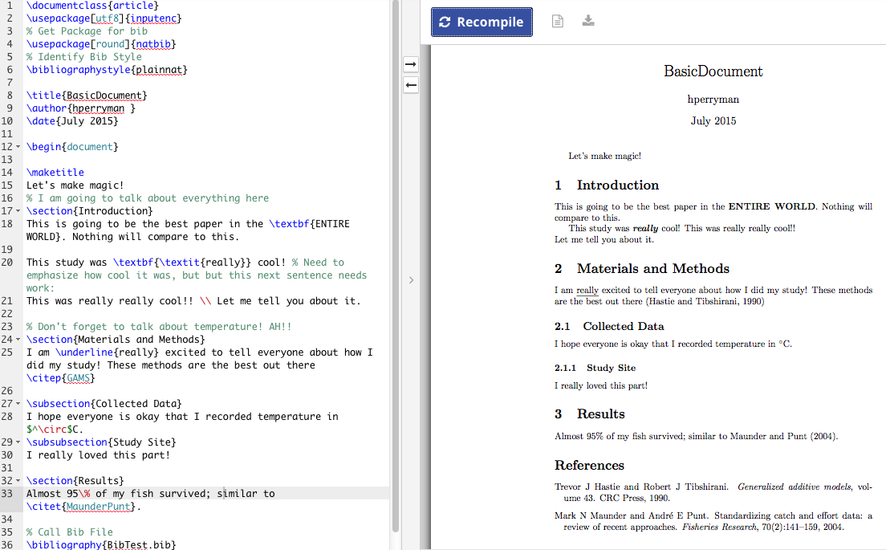

Slide 47
Generating a bibliography
https://en.wikibooks.org/wiki/LaTeX/Bibliography_Management
List of Reference File - a file containing the list of references (e.g., referencelist.bib)
Three lines of code need to be added to the .tex file in order for LATEX to build a bibliography based on the .bib file
A bibliography based on the .bib file will ONLY contain references that are cited within the document text
Citation commands must be in compliance with the declared bibliography package

Slide 48
Presentation Outline
a general breakdown of documents/code
generating a bibliography
examples of basic equations, figures, and tables
taking a look at the UM LaTeX Template

Slide 49
examples of basic equations
https://en.wikibooks.org/wiki/LaTeX/Mathematics
Need to call a math package (e.g., mathtools)
equations and mathematical symbols are only generated while in math mode
There are two ways to activate math mode:
$...$
Best for within sentences
\begin{environment_name} … \end{environment_name}
TWO APPLICABLE ENVIRONMENT: equation, and align
equation: for inserting a single equation
align: for inserting a series of equations (solving)
Allows for in text referencing

Slide 50
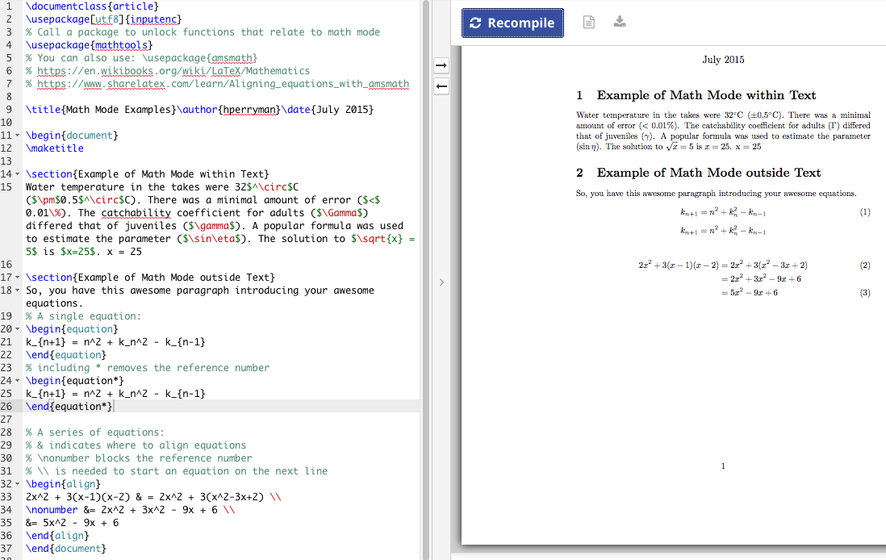

Slide 51
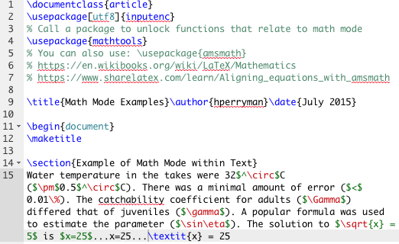
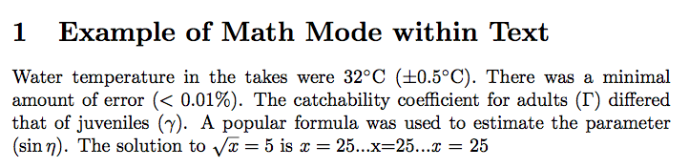

Slide 55
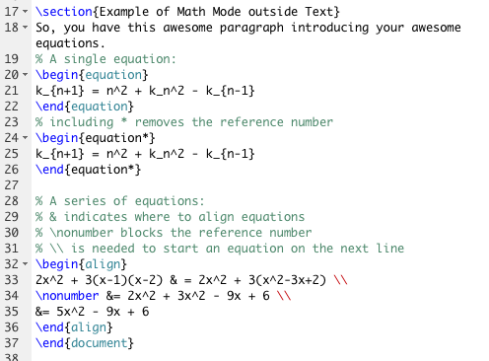
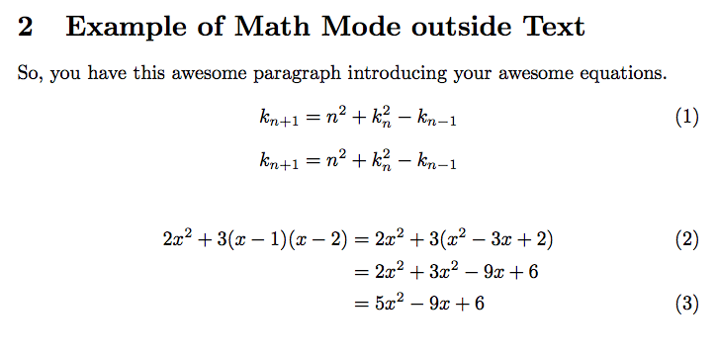

Slide 56
A single equation can be created with an equation environment

Slide 57
A single equation can be created with an equation environment
Using * removes the reference number

Slide 58
A single equation can be created with an equation environment
A series of equations can be created with an align environment

Slide 59
A single equation can be created with an equation environment
A series of equations can be created with an align environment
‘&’ identifies where to align the equations

Slide 60
A single equation can be created with an equation environment
A series of equations can be created with an align environment
‘&’ identifies where to align the equations
\\ is necessary to start a new line

Slide 61
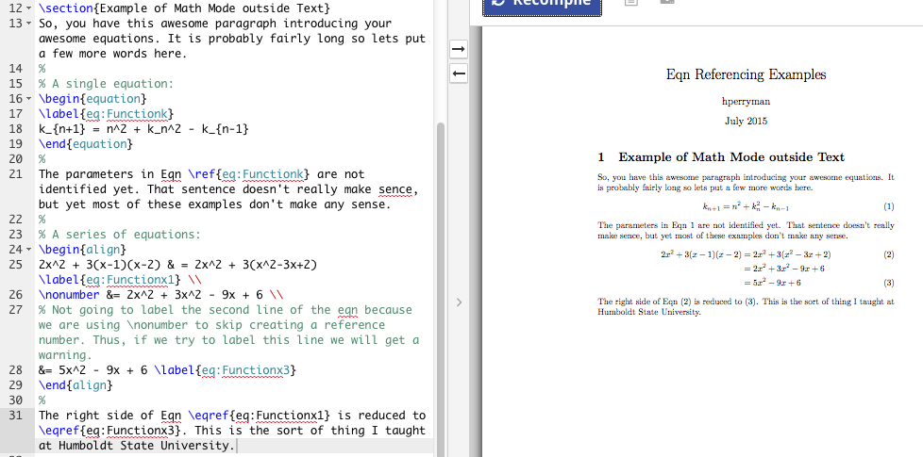
\label{insert_name}
Label environment with insert_name
\ref{insert_name}
Reference environment # for insert_name

Slide 62
Here, the identifier is eq:Functionk

Slide 63
A single equation can be created with an equation environment
Using * removes the reference number
A series of equations can be created with an align environment
‘&’ identifies where to align the equations
\\ is necessary to start a new line
Using * would remove ALL reference numbers, but
\nonumber removes a single reference number

Slide 64
examples of basic figures
https://www.sharelatex.com/learn/Inserting_Images
Need to call package graphicx to get functions for inserting and manipulating images
Images supported by LaTex include:
.jpg (Best for Photo)
.png (best for Diagrams)
.pdf
.eps
Inserting a image within a figure environment allows i) placement adjustment, ii) in text reference, and iii) insert captions

Slide 65
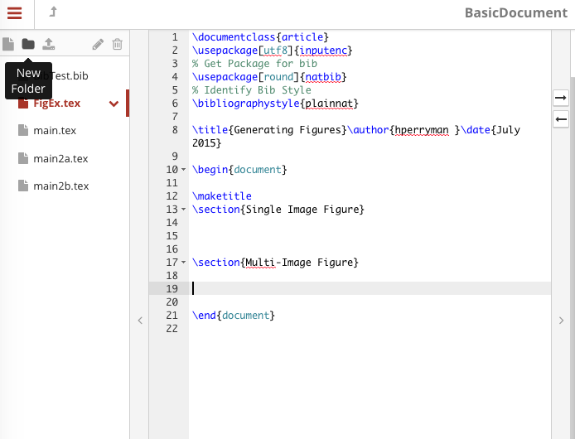
The UM Dissertation LaTeX Template organizes images with a folder called: Figures

Slide 66
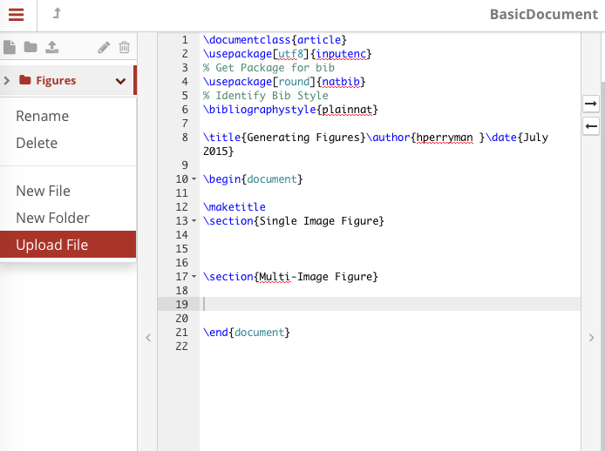

Slide 67
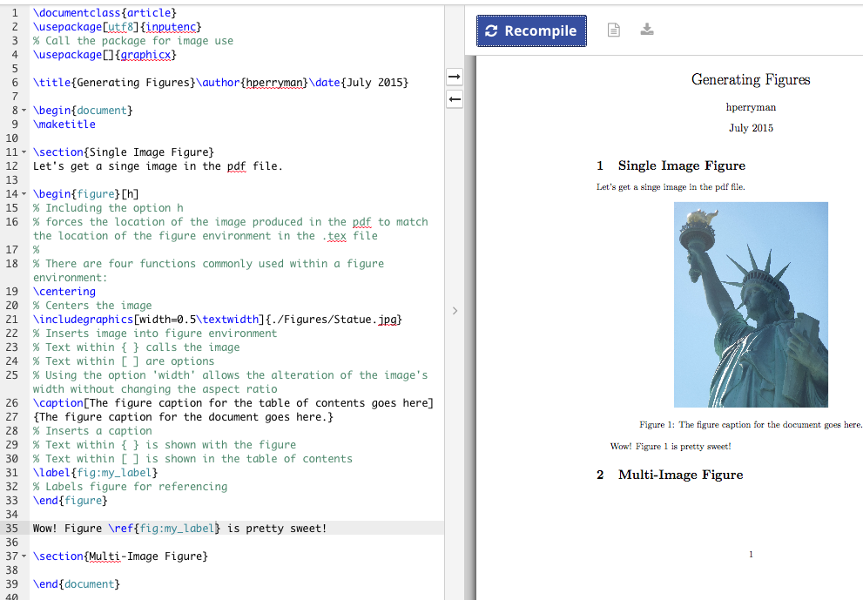

Slide 69
When starting any environment, options can be set within the [ ]
Some position options include:
h : position right here
t : position at top of page
b : position at bottom of page
*For more options see provided websites

Slide 70
Unlike the equation or align environment, the figure environment does not automatically center
\centering will center the graphic

Slide 71
\includegraphics[ ]{ }
The function inserting the graphic
[ ] : indicates options for the graphic
Width: a commonly used option
- set to a measurement (5cm)
- set to a portion (0.5\textwidth)
- For more units see
https://en.wikibooks.org/wiki/LaTeX/Lengths
{ } : indicates the path/directory to the image

Slide 72
Inside an environment a caption can be declared using:
\caption[ ]{ }
[ ] : Text within square brackets will appear in the Table of Contents
{ } : Text within the curly brackets will appear with the graphic

Slide 74
examples of basic figures
https://www.sharelatex.com/learn/Inserting_Images
Need to call package graphicx to get functions for inserting and manipulating images
Inserting a image within a figure environment allows I) placement adjustment, ii) in text reference, and iii) insert captions
The figure environment is a single, floating box. To insert multiple images, we need to create sub-floating boxes, which can be done with the subfig package
https://en.wikibooks.org/wiki/LaTeX/Floats,_Figures_and_Captions

Slide 75
examples of basic tables
https://en.wikibooks.org/wiki/LaTeX/Tables
Basic tables can be added to a document without any additional packages
The cellular structure of a table is generated using the tabular environment
Creating a tabular environment within a table environment allows I) placement adjustment, ii) in text reference, and iii) insert captions

Slide 77
Inside the table environment (just like with the figure environment) we can use the functions
\centering
\caption[ ]{ }
\label{ }
Commonly table captions are above the table, thus the \caption function should be before the construction of the tabular environment

Slide 78
COLUMN STRUCTURE FOR THE tabular ENVIRONMENT IS SET WITHIN THE SECOND SET OF CURLY BRACKETS { }
-column justification (center – c, left – l, right – r)
-number of columns
-vertical lines ( shift + \ = | )

Slide 79
EVERYTHING THAT FOLLOWS \begin{tabular}{…} FILLS IN THE TABLE BEING CONSTRUCTED
NOTE: HORIZONTAL LINES ARE DECLARED USING \hline

Slide 80
TO CREATE A ROW, CELL TEXT IS SEPERATED BY & SYMBOL AND NEW ROWS ARE STARTED WITH \\ SYMBOL
NOTE: MAKE SURE TO REPRESENT EACH COLUMN

Slide 81
REFERENCE THE TABLE WITHIN TEXT USING: \ref{…}

Slide 82
examples of basic tables
https://en.wikibooks.org/wiki/LaTeX/Tables
DEFINE THE WIDTH OF TABLE COLUMNS (ARRAY PACKAGE)
MERGING COLUMNS IN A ROW
MERGING ROWS IN A COLUMN (MULTIROW PACKAGE)
LANDSCAPE TABLES (PDFLANDSCAPE PACKAGE & LANDSCAPE ENVIRONMENT)
MULTIPAGE TABLES (LONGTABLE PACKAGE)

Slide 83
examples of basic equations, figures, and tables
MATH symbols and equations are inserted into a DOCUMENT via math mode
ENVIRONMENTS equation, align, figure, and table make in text referencing possible
Environments figure and table allow you to caption and adjust placement
There is a lot of example code available to you online to copy – paste – edit

Slide 84
Presentation Outline
a general breakdown of documents/code
generating a bibliography
examples of basic equations, figures, and tables
taking a look at the UM LaTeX Template

Slide 85
Getting the Template
You can access the main Blackboard page at www.miami.edu/blackboard
Under the My Organizations tab select Electronic Thesis and Dissertations
Select Discussions ➔ Templates and Advice ➔ LaTeX Templates
Click on “LaTeX Template” to download DissertationTempate.zip
Upload into ShareLatex (or preferred program)

Slide 86
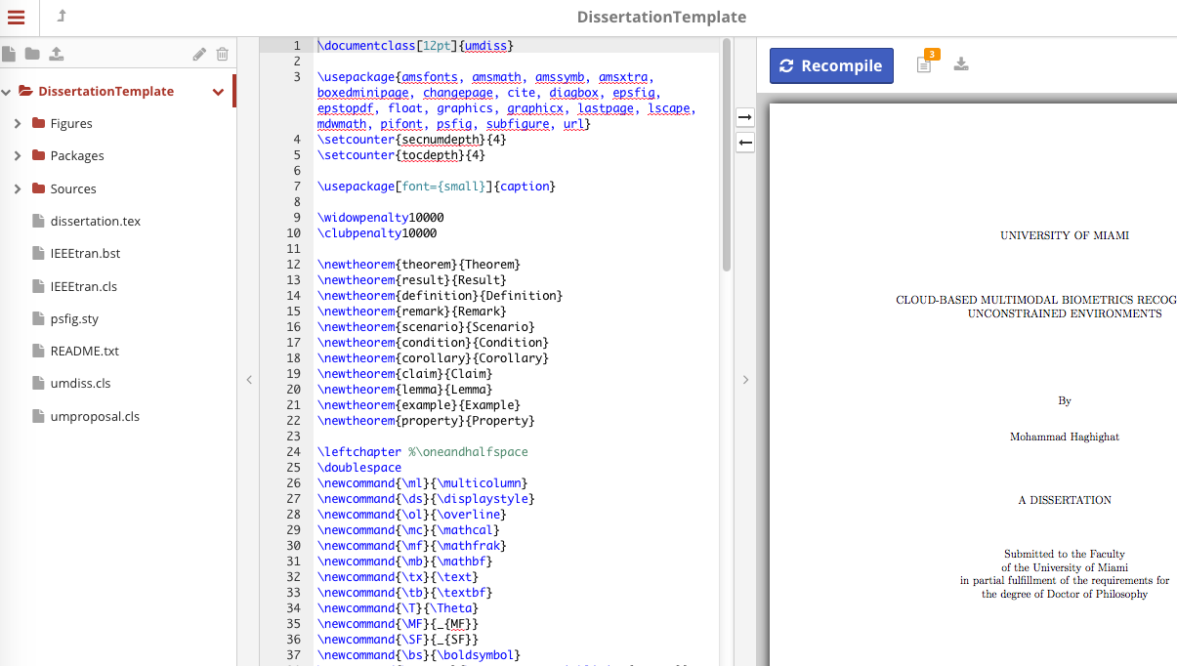

Slide 87
Working with the Template
dissertation.tex is the input file
the tex file create your document
This is where you edit the preamble (i.g., add packages, change bibliography style) and edit document environment

Slide 88
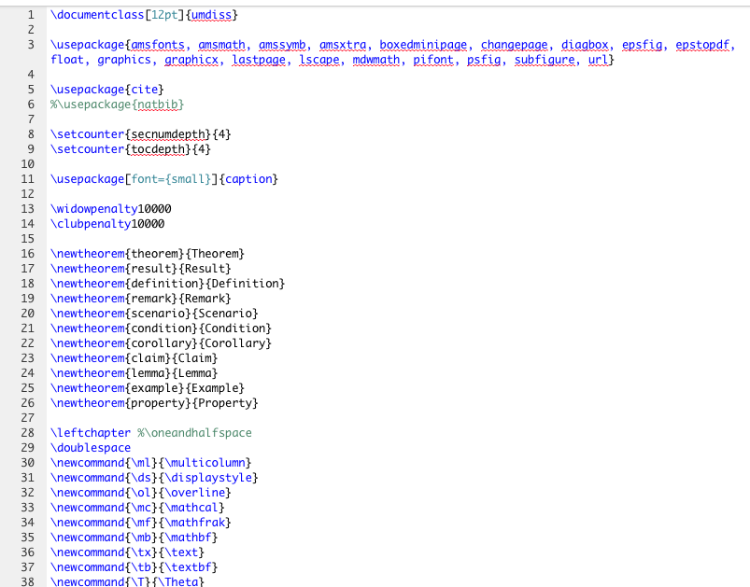
Notice bibliography setup in dissertation.tex
You will notice that the cite package is used, NOT the natbib package
And that the called bibliography style is instead IEEEtran – a created style
chapter2.tex has some example code, including how to cite a reference in this template

Slide 89
Working with the Template
dissertation.tex is
the tex file create your document
This is where you edit the preamble (i.g., add packages, change bibliography style) and edit document environment
Edit cover page (e.g., name, committee, etc.)

Slide 91
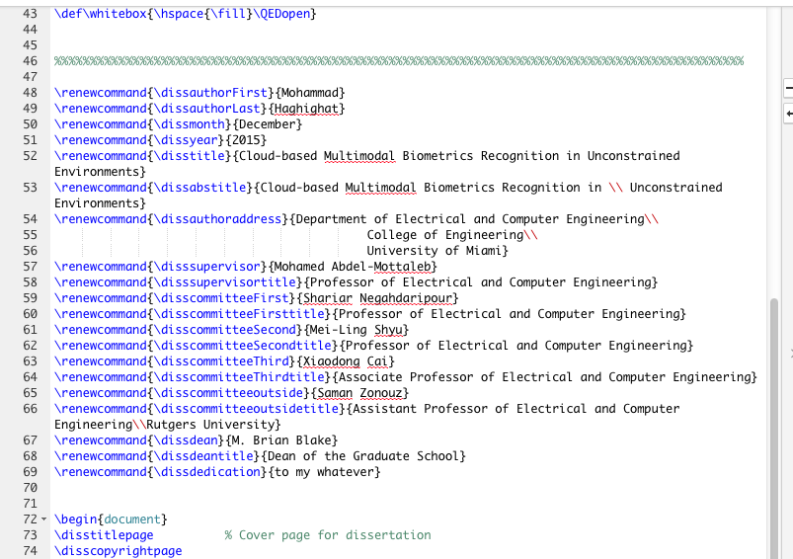
In dissertation.tex – Below comment line MUST be edited

Slide 92
Working with the Template
dissertation.tex is
the tex file create your document
This is where you edit the preamble (i.g., add packages, change bibliography style) and edit document environment
Edit cover page (e.g., name, committee, etc.)
Add/remove chapters and appendixes

Slide 93
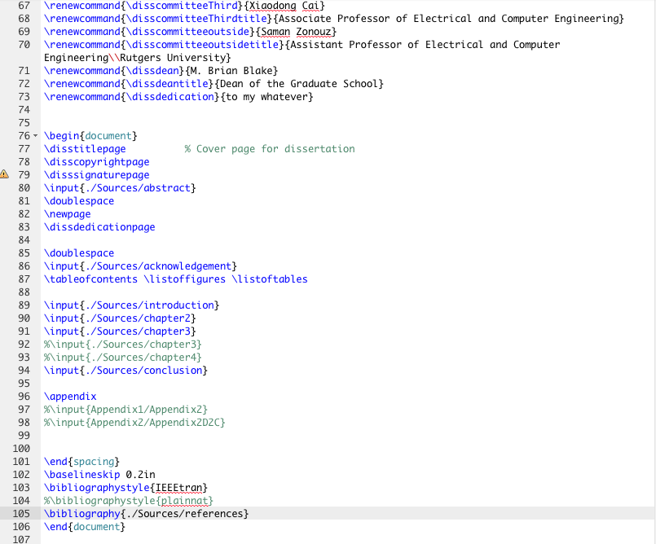
In dissertation.tex – Add / Remove chapter and appendix .tex files

Slide 94
Working with the Template
dissertation.tex is
the tex file create your document
This is where you edit the preamble (i.g., add packages, change bibliography style) and edit document environment
Edit cover page (e.g., name, committee, etc.)
Add/remove chapters and appendixes
Edit all files in sources folder

Slide 95
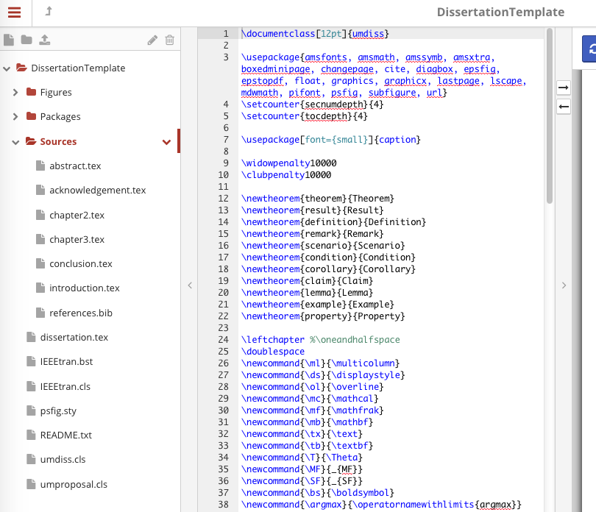
chapter2.tex can be referred to as an example

Slide 96
chapter2.tex can be referred to as an example

Slide 97
Summary
LaTex is a free document preparation system that allows the writer for focus more on content and less on design
there are many online sources available to help identify the necessary code/functions/packages – so don’t fear the language!
The UM LaTeX Help Forum is available to you to discuss template issues (where you downloaded the template & LATEX Workshop Documents)
Using the UM Dissertation Template can streamline your dissertation writing process, so take advantage of it!

Slide 98
Word Processors? Ain’t Noobody Got Time For That: Introduction tO
By Holly Perryman
Wednesday, March 30th

Slide 99
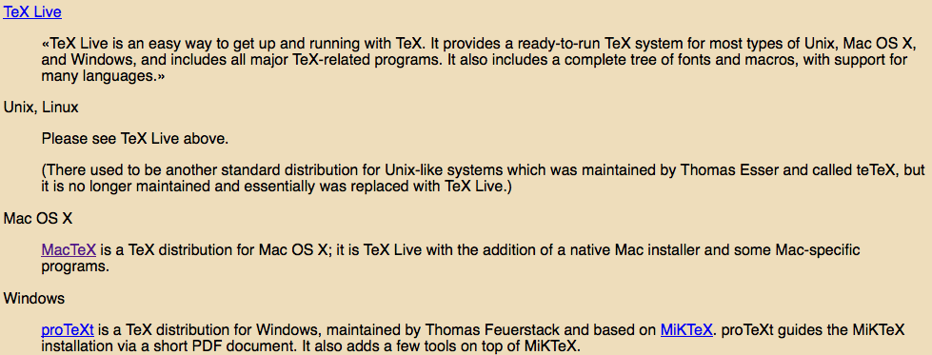
Getting it on your computer

Slide 102
Generating Math Symbols and Equations
For equations and mathematical symbols to be generated math mode must be activated, which requires the mathtools package
Equations generated within an environment can be labeled for in-text referencing
\label{identifier} – labels item
\ref{identifier} – references item
https://en.wikibooks.org/wiki/LaTeX/Labels_and_Cross-referencing

Slide 104
Here, the identifier is eq:Functionk

Slide 105
Here, the identifier is eq:Functionk
NOTE:
LaTeX users often include an abbreviation indicating the item type as part of the marker_name. I.E.,
Equation - eq:name
Table - tab:name
Figure - fig:name
see more at https://en.wikibooks.org/wiki/LaTeX/Labels_and_Cross-referencing

Slide 106
\ref(eq:Functionk)
will generate the number associated to that equation

Slide 108
In the align environment
\label{…} will mark the equation on that line

Slide 109
\eqref(…)
Inserts parenthesis around the number

Slide 110
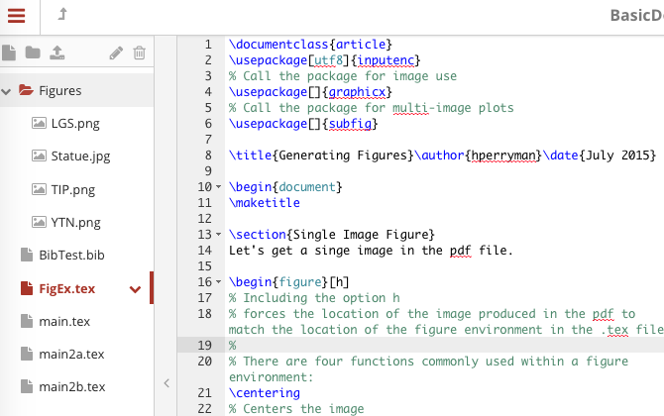

Slide 111
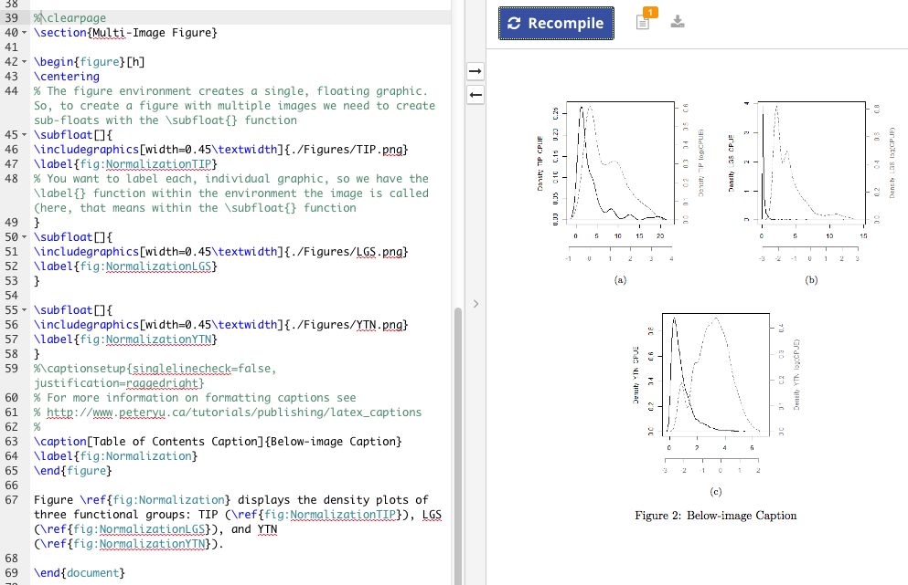

Slide 112
Within the figure environment the \subfloat[ ]{ } function is activated before the \includegraphics[ ]{ } function is used to call the graphic
To label individual graphics for referencing, the \label{ } function must be inside the \subfloat[ ]{ } function

Slide 114
The [ ] after \subfloat are necessary to create the sub-captions below each image (i.e., a, b, c, etc.)
Notice that line 54 is empty; empty lines will cause the following image(s) to be below the previous image(s)

Slide 115
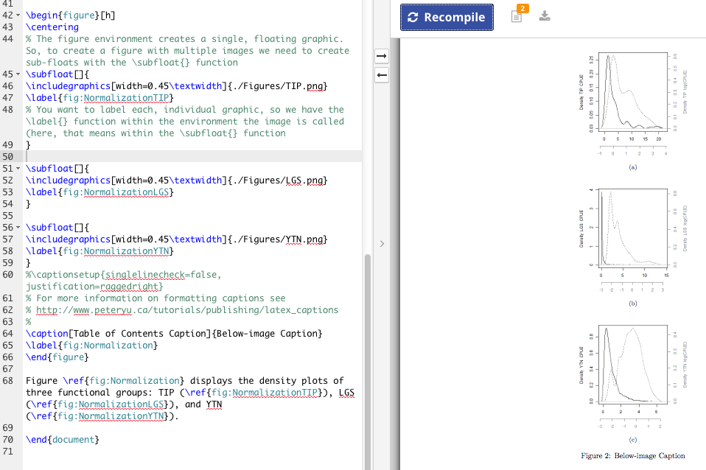

Slide 116
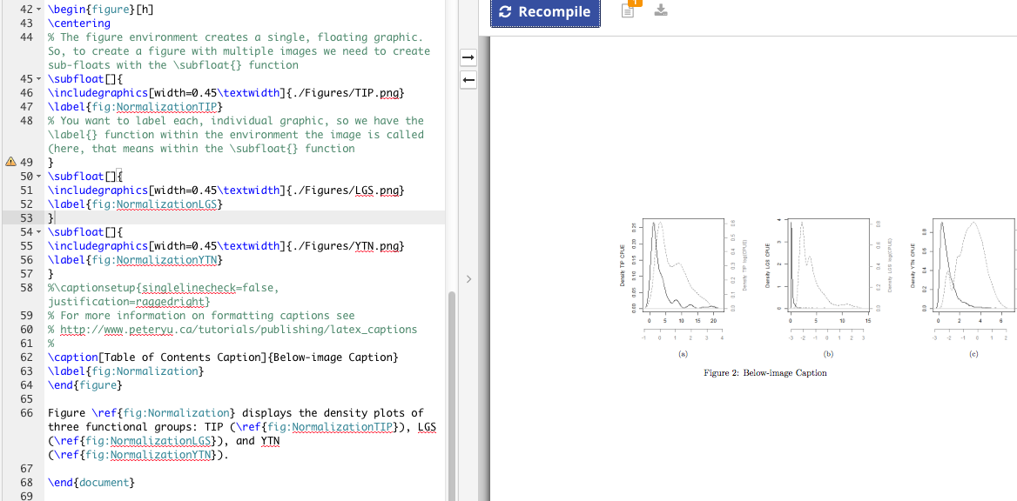

Slide 118
Inside the figure environment a caption can be declared using \caption[ ]{ }
\label in the figure environment labels the figure number, while \label in the \subfloats label the individual graphics

Slide 120
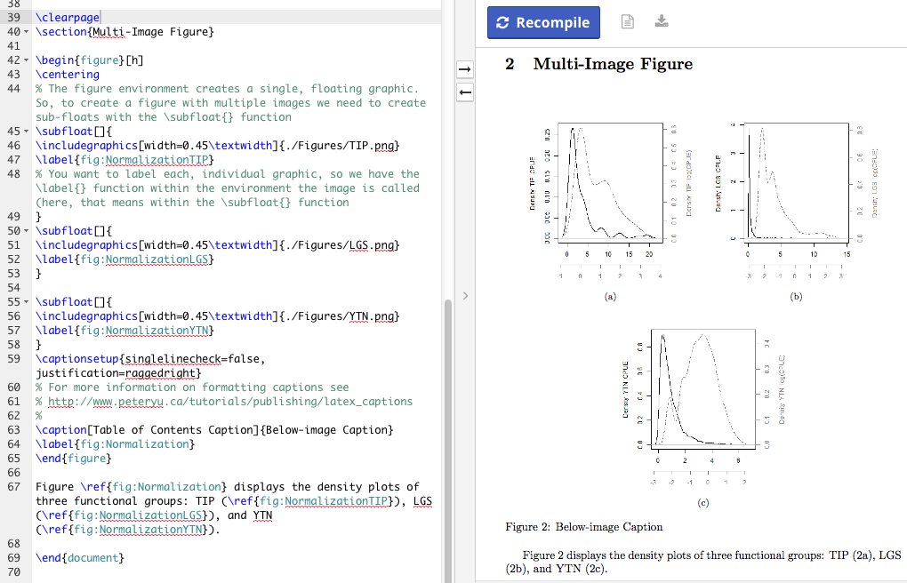
\clearpage forces all of the following text to the next page
NOTE:
The function \newpage does not work well for floating objects (i.e., figures)

Slide 121
\captionsetup{ } Allows for some manipulation to the environment’s captions
Only the captions following \captionsetup{ } within the environment will be impacted
Call package to alter ALL captions:
\usepackage[singlelinecheck=false]{caption}
http://www.peteryu.ca/tutorials/publishing/latex_captions

Slide 122
The current version of the available template works. If you open it for the first time and receive any errors, it is because of the program/compiler – NOT the template.
When in doubt, recompile several times in a row

Slide 123
For example:
When I uploaded dissertationtemplate.zip into ShareLatex for the first time the bibliography did not work, at first. However, the bibliography worked in a different program.
Solution for ShareLatex: I MOVED references.bib out of the Sources folder and into the DissertationTemplate folder (Doing this means you also need to change the code in the dissertation.tex calling the .bib file: \bibliography{references})

